Slide 1
Agent Migration during Human-Robot Joint Task
By Marlow, Madelyn, Si, and Talha

Slide 2
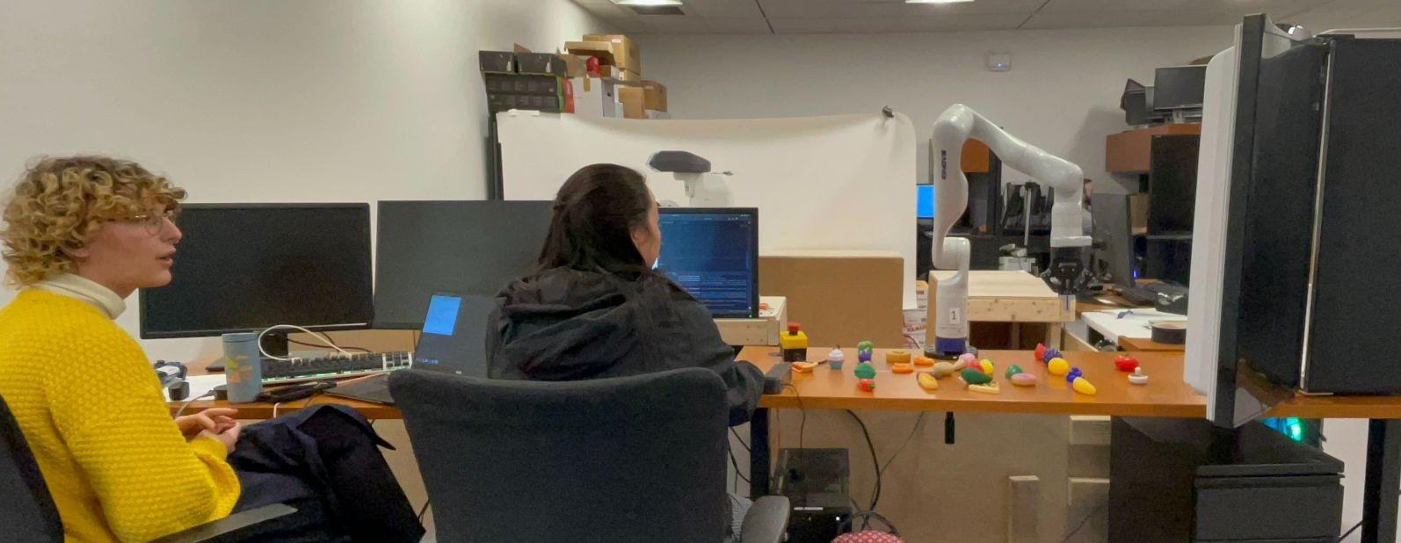
Why did you pick your project?
Human-Robot Team Adaptability
getting used to new people vs. new technology
Integrated Assistive Robotics

Slide 3
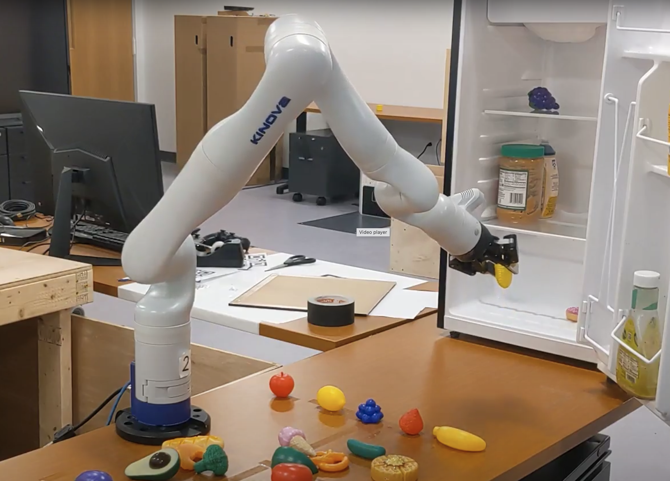
The Task
Put away groceries!
develop a human-robot relationship
create a “life agent”
Analyzing:
agent migration
preference transfer
task transfer
trust transfer
capacity, moral
Video link:
https://drive.google.com/file/d/1_H99MCVlODJtdmO7nKZPWcK1qvZpLX7G/view?usp=sharing

Slide 4
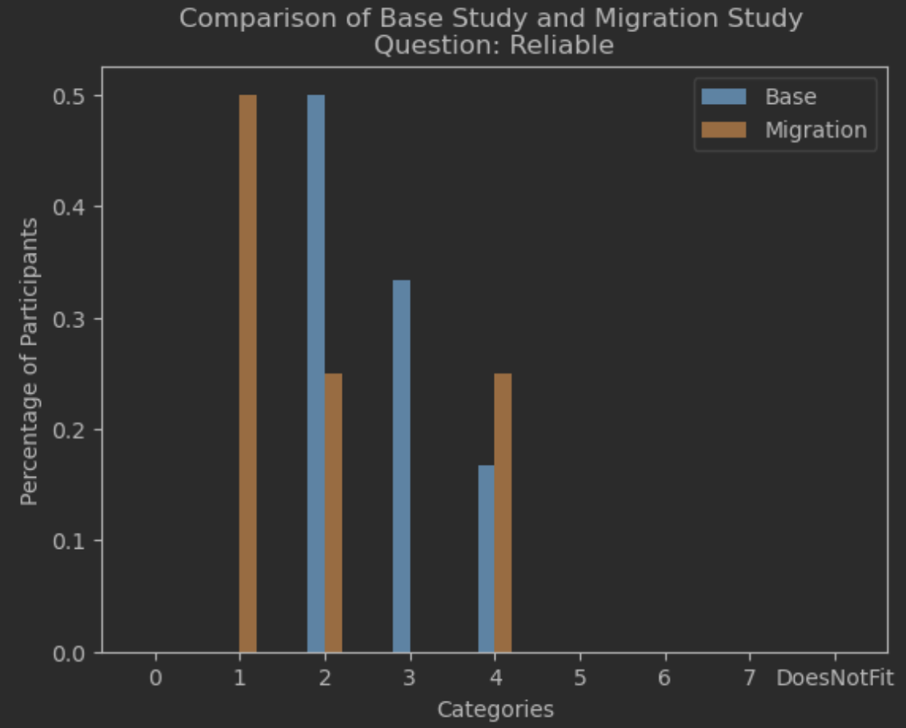
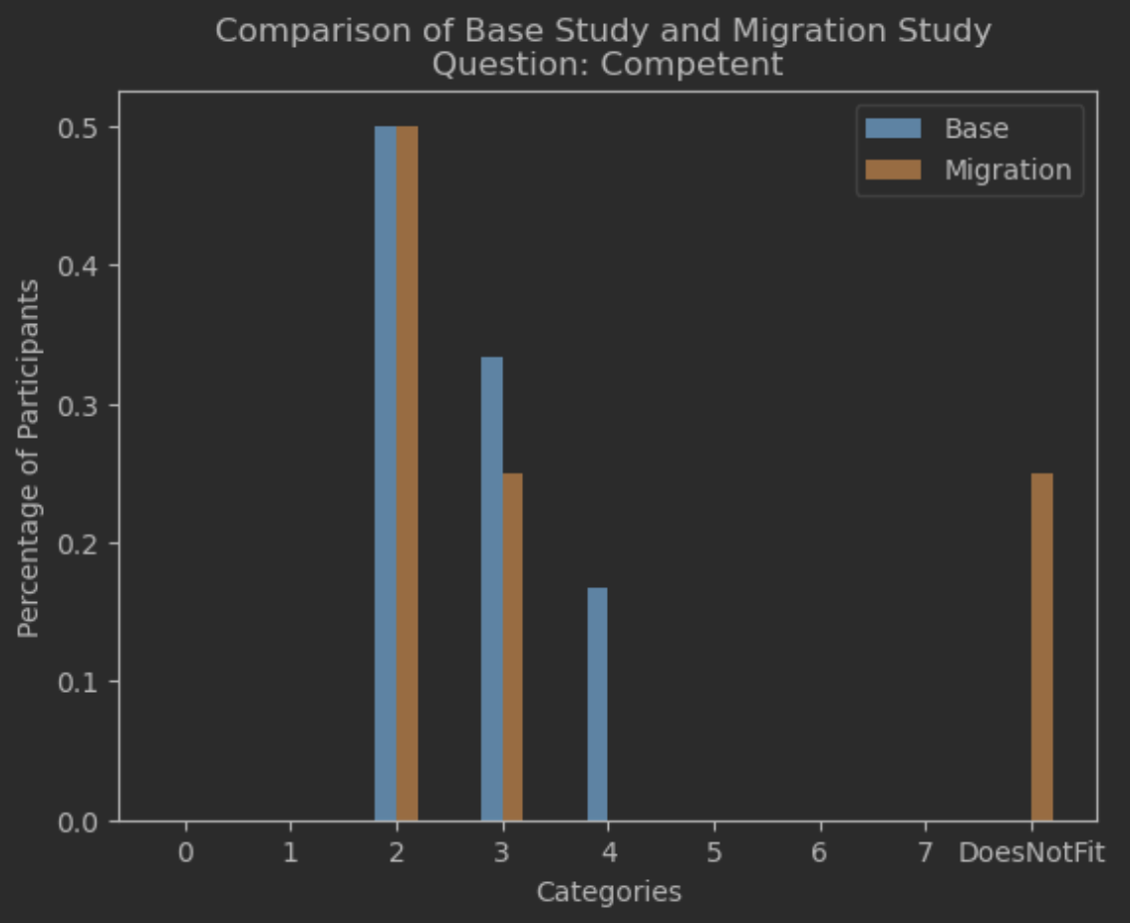
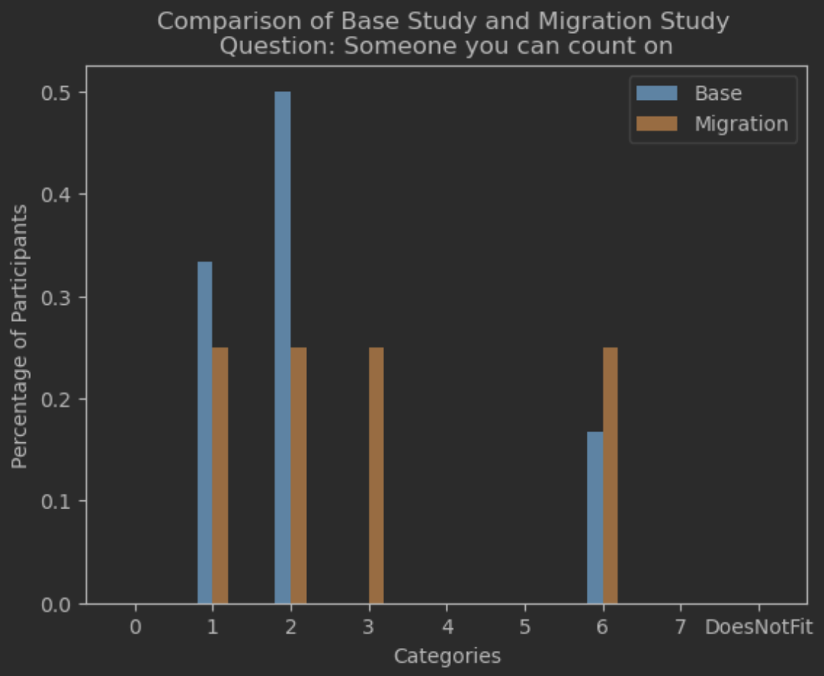
Results
Due to small sample size, we can’t use statistical hypothesis testing such as t-test
Data visualization shows no obvious drop in ratings from control to migrant studies
The agent migration might not have an effect on people’s trust of the robot
Notes:
•No statistical hypothesis testing such as t-test
•T-test is used to compare the means of two groups (control vs. migration)
•Certain assumptions must be met
•The data should be approximately normally distributed within each group.
•The variances between the two groups should be similar
With a small sample size, these assumptions are hard to verify.

Slide 5
Retrospective
Implementation
Successes
Preference learning
Users quickly understood task
Needs Improvement
Inconsistent pick & place
Limited interaction modalities
Results
Successes
Low participant expectancy
Positive interaction feedback
Varied subject familiarity in robotics
Needs Improvement
More data needed on UX
Inconsistent experiment length
Low # of participants (n = 10)

Slide 6
Next Steps
Implementation
ASR
Smoother & predictable robot trajectories
Vision-enabled pick & place
Expanded interaction modalities
Results
More participants
More conditions (2x2)
Longer experiments (build more rapport)
Examine effects with heterogeneous morphologies

Slide 7
Most Interesting Things We Learned
They thought there were 2 robots
They would pay little to buy the robots: $12 - $200
“I would probably pay like 50 bucks, it’s be cool”
“I wouldn't want this robot to put away groceries in my home”
People were not surprised when robots “broke down”
Notes:
(They just immediately accepted it without even showing much emotion or questioning why it broke down). It's like robots breaking down is a more common phenomenon than it ideally should be and the general reliability of robots need to increase for the general trust level of people to go up.

Slide 8
Suggestions for future COMP 133 students
Be open to other insights that might emerge as you are investigating your primary hypothesis.
Really differentiate your control from the experiment to avoid any potential confusions.
Get more human subjects than is necessary to account for bad results.
Review a lot of literature
Get started early with any skills that might be necessary to implement the study, e.g. ROS.

